Slide 1


Real Estate Price Prediction in Bangalore
This presentation explores a data-driven approach to predicting real estate prices in Bangalore, India's Silicon Valley, using advanced machine learning techniques. By leveraging historical data and key market factors, we aim to provide valuable insights to homebuyers, investors, and developers.
by 21-533

Slide 2

PROBLEM STATEMENT
1
Accurate Price Estimation
2
Insights for Stakeholders
3
Market Trends Analysis
Identifying key trends and patterns in the Bangalore real estate market to inform future planning and investment strategies.
Developing a model that can accurately predict real estate prices in Bangalore, taking into account various influencing factors.
Providing valuable insights to homebuyers, investors, and developers to support their decision-making process.

Slide 3
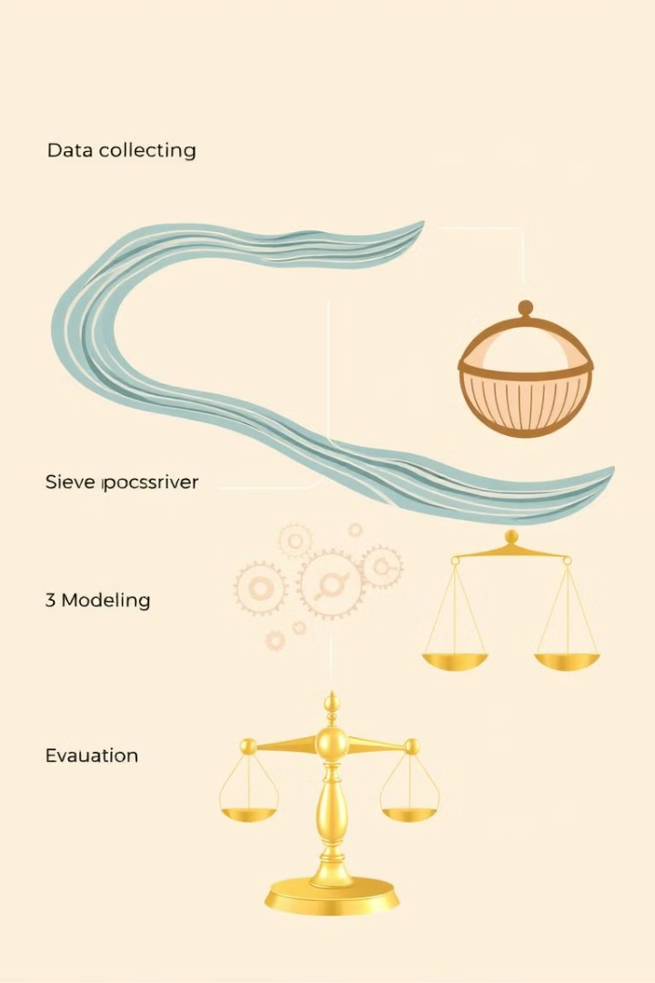
METHODOLOGY
1
Data Collection
Gather comprehensive real estate data from various sources, including property listings, market reports, and economic indicators.
2
Preprocessing
Clean, standardize, and transform the data to prepare it for modeling, addressing missing values and outliers.
3
Feature Engineering
Identify and extract relevant features from the data that can influence real estate prices, such as location, size, amenities, and market conditions.

Slide 4
IMPLEMENTATION
Model Selection
Model Training
Model Evaluation
Evaluate various regression algorithms, such as Linear Regression, Random Forest, and K-Nearest Neighbors, to determine the most suitable model for the task.
Split the data into training and testing sets, and train the selected model using the training data, optimizing hyperparameters as needed.
Assess the model's performance on the testing data, using metrics like R-squared, Mean Squared Error, and Root Mean Squared Error.

Slide 5

Dataset Description and Exploration
Data Sources
Key Attributes
The dataset was compiled from various real estate portals and market reports, covering residential properties in Bangalore.
The dataset includes attributes such as property type, size, location, number of bedrooms, and sale price.
Exploratory Analysis
Data Quality
Preliminary analysis revealed trends and patterns in the data, informing feature engineering and model selection.
The dataset was carefully cleaned and validated to ensure accuracy and reliability for the price prediction task.

Slide 6
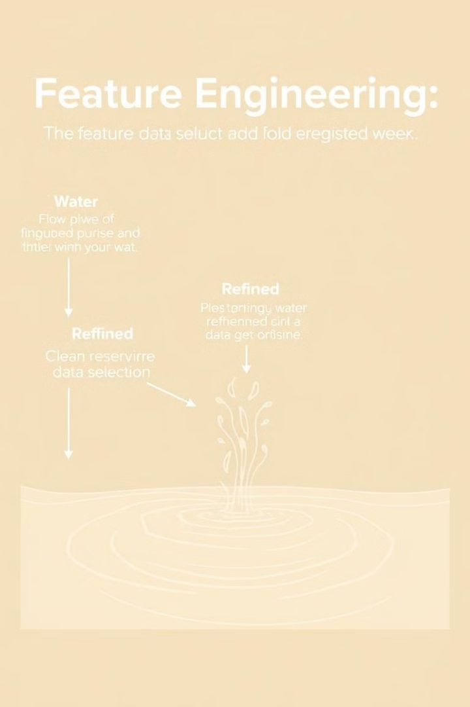
Preprocessing and Feature Engineering
1
Data Cleaning
Handled missing values, removed outliers, and standardized data formats to ensure data integrity.
2
Feature Selection
Identified the most relevant features that influence real estate prices, such as location, size, and amenities.
3
Feature Engineering
Created new features by combining and transforming the original data, enhancing the model's predictive power.

Slide 7
Model Training and Evaluation
Model Selection
Hyperparameter Tuning
Model Evaluation
Compared the performance of various regression models, including Linear Regression, Random Forest, and K-Nearest Neighbors.
Optimized the model's hyperparameters to achieve the best possible performance on the validation set.
Assessed the model's predictive accuracy using metrics like R-squared, Mean Squared Error, and Root Mean Squared Error.

Slide 8
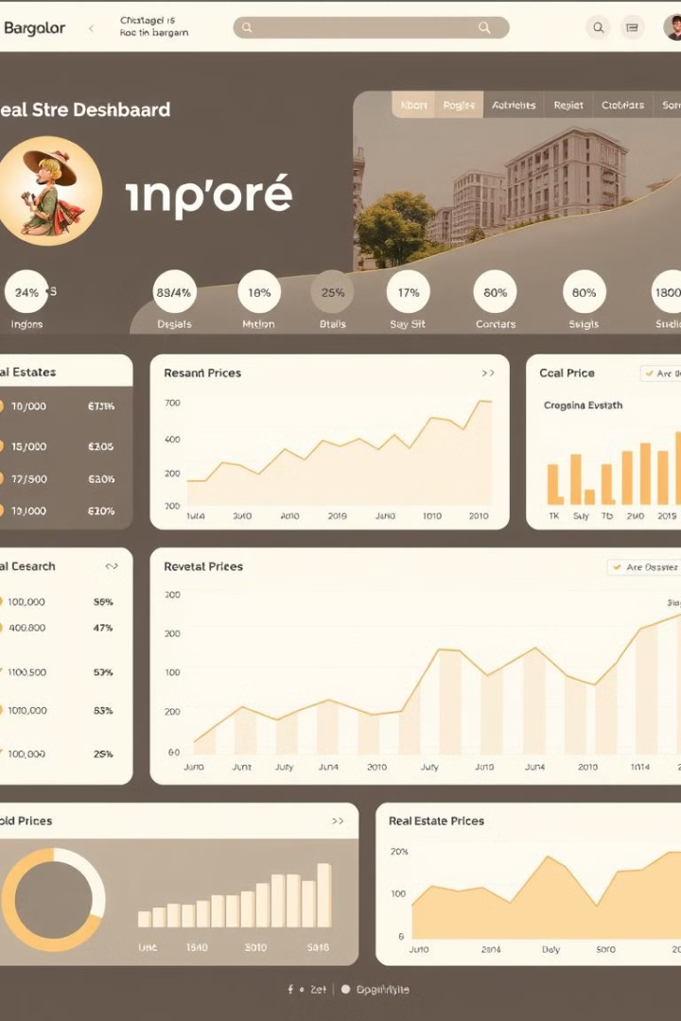



DATA VISUALIZATION
Spatial Analysis
Visualize the geographical distribution of property prices and identify high-value neighborhoods.
Price Trends
Analyze historical price trends and patterns to understand market dynamics and identify investment opportunities.
Customizable Filters
Allow users to explore the data interactively, applying filters based on property attributes and location.

Slide 9
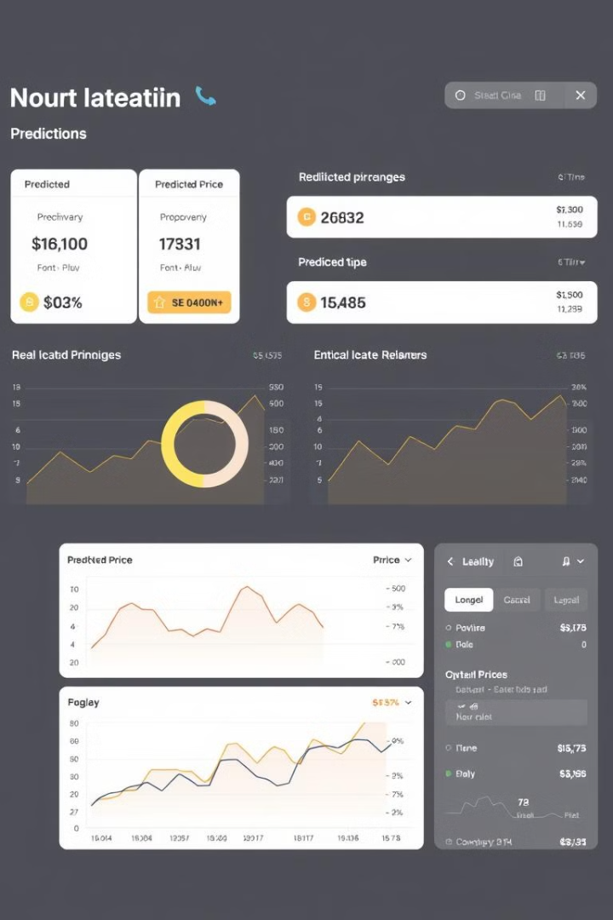



Predictions and Insights
Price Prediction
The trained model can accurately predict the sale price of a property based on its attributes and market conditions.
Influencing Factors
Identify the key factors that have the greatest impact on real estate prices, such as location, size, and amenities.
Investment Opportunities
Highlight undervalued neighborhoods and property types that may offer attractive investment prospects.

Slide 10

Conclusion and Future Directions
Key Takeaways
Future Enhancements
The real estate price prediction model developed in this project can provide valuable insights to homebuyers, investors, and developers in the Bangalore market.
Explore incorporating additional data sources, such as economic indicators and market sentiment, to further improve the model's accuracy and utility.
Scalability and Deployment
Investigate ways to scale the model and deploy it as a user-friendly application to enhance its real-world applicability.

